Slide 1

DEPARTMENT OF COMPUTER SCIENCE & ENGINEERING
TITLE:EARLY PREDICTION OF PARKINSON’S DISEASE SEVERITY
DOMAIN: ARTIFICIAL INTELLIGENCE & MACHINE LEARNING
BATCH - 14
SUPERVISOR
COORDINATOR
PRESENTED BY
S. Triveni
Assistant Professor
Dept of CSE
MD. Sharfuddin Waseem
Assistant Professor
Dept of CSE
P. Abhinav (B22CS001)
K. Kavya (B22CS019)
A. Harshini (B22CS050)
V. V. Vishnu. S (B22CS060)

Slide 2
CONTENTS
1. Abstract
2. Problem Statement
3. Objectives
4. Literature Review
5. Requirements
6. Methodology and Architecture
7. Inputs and Outputs
8. ML Algorithms
9. Model Evaluation
10.Suggestions
11.Future Scope
12.Conclusion
13.References

Slide 3
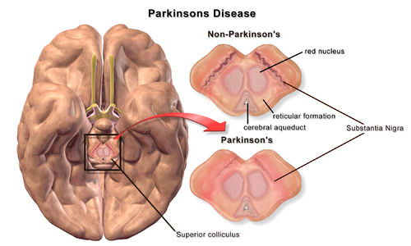
ABSTRACT
Parkinson’s Disease (PD) is a chronic, progressive neurodegenerative disorder affecting about 1% of people over 60, with both motor and non-motor symptoms.
The study aims to develop a machine learning model to predict PD severity levels (Mild, Moderate, Severe) using clinical variables based on UPDRS criteria.
The model was trained on 2,105 patient samples with 31 variables, including demographic, vital, lifestyle, and motor symptom data..
The ensemble model achieved 51.4% overall accuracy, 94% recall for severe cases, and 100% accuracy for well-defined patients.
The model is interpretable using feature importance and includes a user-friendly graphical interface, making it useful as a clinical decision support system for PD management.

Slide 4
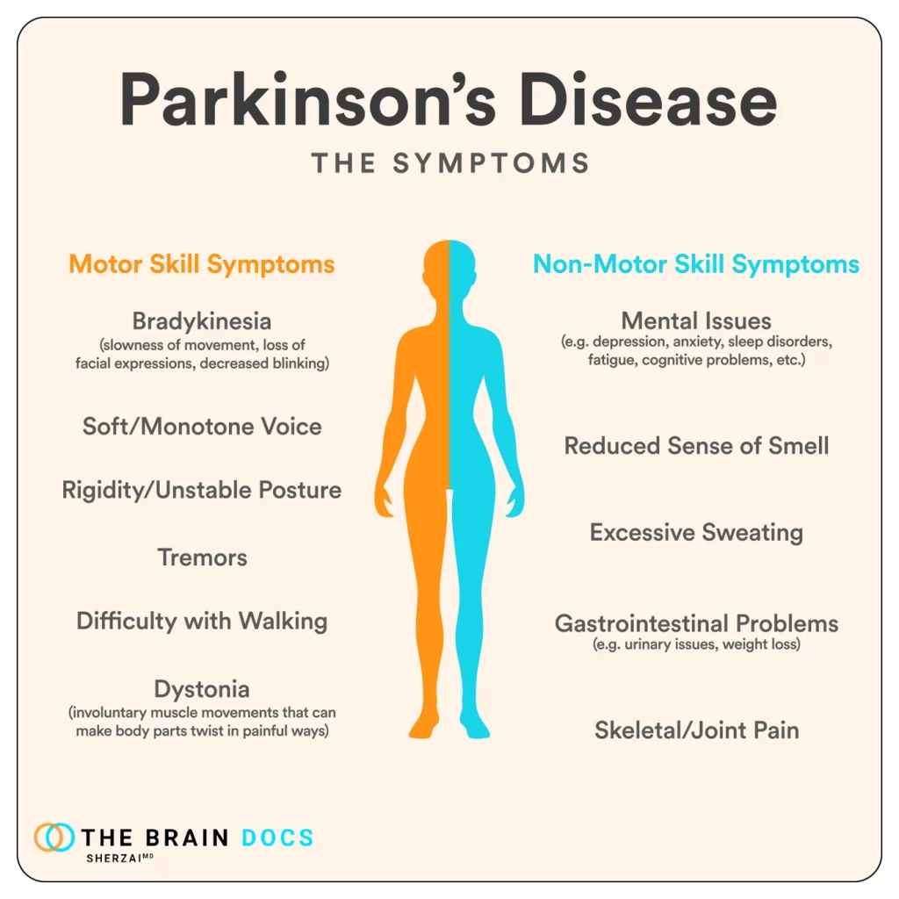
PROBLEM STATEMENT
Parkinson’s Disease severity is traditionally evaluated using UPDRS, which requires expert clinical assessment and may delay timely treatment decisions.
Most existing machine learning models focus only on binary classification (PD vs. Healthy) rather than predicting multiple severity levels (Mild, Moderate, Severe).
There is significant symptom overlap between mild and moderate cases, making accurate multi-class classification challenging.
Medical datasets often contain more severe cases than mild/moderate ones, leading to biased model predictions.
Many AI models lack transparency, making it difficult for doctors to trust and apply them in real-world clinical decision-making.

Slide 5
OBJECTIVES
To develop a multi-class machine learning model that predicts Parkinson’s Disease severity levels (Mild, Moderate, Severe) based on UPDRS criteria.
To build an ensemble-based classification system by integrating Random Forest, Logistic Regression, and Gradient Boosting for improved predictive performance.
To handle class imbalance effectively using techniques like SMOTE and class weighting to ensure fair prediction across all severity levels.
To perform optimized feature selection using Recursive Feature Elimination (RFE) to identify the most influential clinical factors affecting PD severity.
To ensure model interpretability through feature importance analysis so that clinicians can understand the reasoning behind predictions.
To design a user-friendly graphical interface (GUI) for practical clinical application as a decision support tool.
To validate the model’s reliability using cross-validation and multiple evaluation metrics such as accuracy, precision, recall, and F1-score.

Slide 6
LITERATURE REVIEW
Most previous studies on Parkinson’s Disease focused on binary classification (PD vs. Healthy). Speech-based models achieved about 86% accuracy, and gait-based models achieved around 84%. However, these approaches do not address multi-level severity prediction.
Some deep learning approaches attempted three-level severity classification and achieved around 72% accuracy, but they relied on specialized sensors and complex data collection methods, limiting real-world clinical applicability.
Ensemble methods such as Random Forest and Gradient Boosting have shown strong performance in medical prediction tasks due to their ability to handle nonlinear relationships and improve robustness.
Medical datasets are often imbalanced. Techniques like SMOTE (Synthetic Minority Over-sampling Technique) have been successfully applied in various healthcare prediction problems to improve minority class detection.
Feature selection techniques like Recursive Feature Elimination (RFE) and LASSO help identify important clinical biomarkers and reduce model complexity while improving performance.

Slide 7
TOOLS,TECHNOLOGY AND DATASET
Python used for data processing and machine learning model development
Key libraries: Pandas, NumPy, Scikit-learn, Imbalanced-learn (SMOTE)
Model optimization techniques: RFE, Bayesian Optimization, Stratified K-Fold Cross-Validation
Ensemble algorithms: Random Forest, Logistic Regression, Gradient Boosting
Visualization and interface tools: Matplotlib, Seaborn, Tkinter (GUI development), Joblib (model saving/loading)
Dataset: Structured clinical Parkinson’s Disease dataset (2,105 patient records, 31 variables based on UPDRS criteria)
Data split into training (80%) and testing (20%) for model evaluation

Slide 8
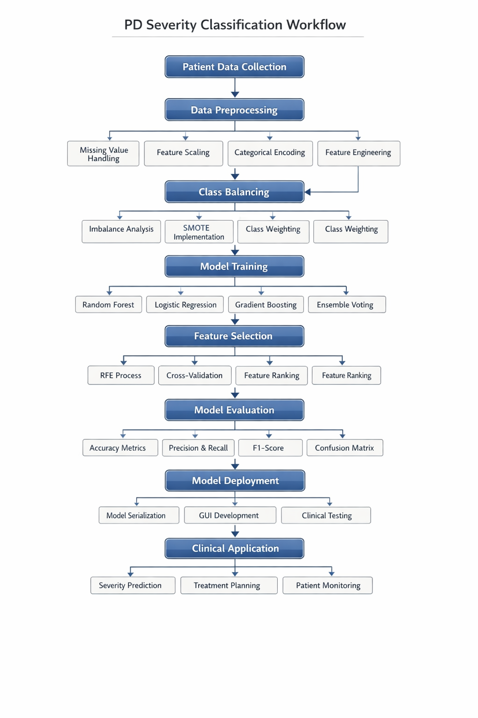
METHODOLOGY & ARCHITECTURE
Collect structured clinical Parkinson’s dataset (2,105 records, 31 variables).
Preprocess data (missing value imputation, encoding, scaling) and categorize UPDRS into Mild, Moderate, Severe.
Balance classes using SMOTE and apply feature selection using RFE.
Train a weighted ensemble model (Random Forest + Logistic Regression + Gradient Boosting) with hyperparameter tuning.
Predict PD severity level and evaluate using Accuracy, Precision, Recall, F1-score, and Confusion Matrix.
Architecture (Simple Flow): Dataset → Preprocessing → SMOTE + Feature Selection → Ensemble Model → Severity Prediction → Evaluation

Slide 9
INPUTS & OUTPUTS
Inputs:
Clinical and patient health parameters.
Total of 31 features used for prediction.
Examples: Age, BMI, Blood Pressure, Cholesterol levels, MoCA score, Functional assessment, Tremor, Rigidity, Bradykinesia, Sleep quality, Physical activity, Alcohol consumption, Family history, etc.
User provides values through a graphical user interface (GUI) or clinical data entry system.
Outputs:
Predicted Parkinson’s Disease severity level (Mild / Moderate / Severe).
Probability scores for each severity class.
Identification of high-risk (Severe) cases.
Feature importance insights explaining key influencing factors.
Clinical support suggestions for monitoring and treatment planning.

Slide 10
MACHINE LEARNING ALGORITHMS USED
Random Forest Classifier
Logistic Regression (Multinomial)
Gradient Boosting Classifier
Weighted Soft-Voting Ensemble (combination of the above three models)
Recursive Feature Elimination (RFE) – for feature selection
SMOTE (Synthetic Minority Over-sampling Technique) – for class balancing
Bayesian Optimization – for hyperparameter tuning

Slide 11
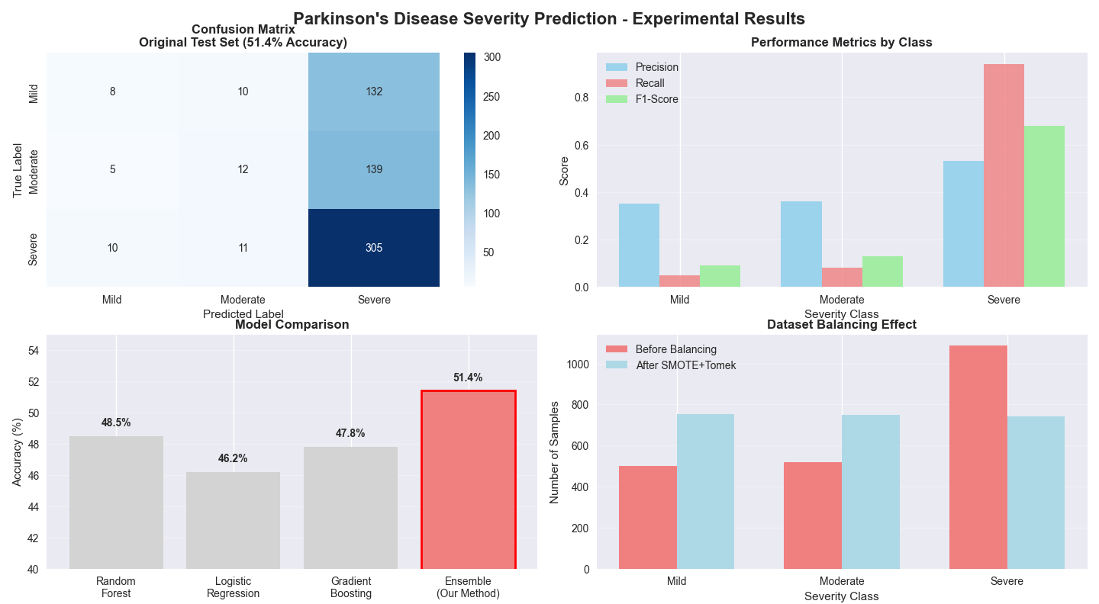
MODEL EVALUATION
Data Split: Training = 80% and Testing = 20%.
Cross-validation = 10-fold Stratified Cross-Validation.
Metrics Used: Accuracy, Precision, Recall, F1-Score, Confusion Matrix.
Results:
Overall Accuracy: 51.4%
10-fold CV Accuracy: 49.2% +/- 2.3%
Severe Class Recall: 94%
Macro F1-Score: 0.46
Weighted F1-Score: 0.45

Slide 12
SUGGESTIONS
Incorporate longitudinal (time-series) patient data to improve differentiation between Mild and Moderate cases.
Integrate advanced features such as genetic markers, brain imaging data, or wearable sensor data for better accuracy.
Perform multi-center external validation to test model generalization across diverse populations.
Optimize severity threshold definitions to better align with real-world clinical assessment standards.
Enhance model interpretability using advanced explainable AI techniques (e.g., SHAP) to increase clinician trust and adoption.

Slide 13
FUTURE SCOPE
Develop a real-time monitoring system by integrating wearable devices for continuous symptom tracking.
Extend the model to predict disease progression trends over time using longitudinal data.
Incorporate deep learning techniques to improve multi-class severity classification accuracy.
Deploy the system as a cloud-based clinical decision support platform for hospital integration.
Expand the model to support personalized treatment recommendations based on patient-specific risk profiles.

Slide 14
CONCLUSION
This research presents an interpretable ensemble-based machine learning model for predicting Parkinson’s Disease severity using standard clinical data. The system classifies patients into Mild, Moderate, and Severe categories based on UPDRS criteria and achieves an overall accuracy of 51.4%, with a high recall of 94% for severe cases. The use of SMOTE for class balancing, RFE for feature selection, and a weighted ensemble of Random Forest, Logistic Regression, and Gradient Boosting improves robustness and reliability.
Although distinguishing mild and moderate cases remains challenging due to symptom overlap, the model performs effectively in identifying high-risk severe patients, making it valuable as a clinical decision support tool. The inclusion of feature importance analysis and a user-friendly GUI enhances interpretability and real-world applicability. Overall, this work demonstrates the potential of machine learning to assist clinicians in Parkinson’s Disease severity assessment and management.

Slide 15
REFERENCES
A. J. Hughes et al., "The accuracy of diagnosis of parkinsonian syndromes in a specialist movement disorder service," Brain, vol. 125, no. 4, pp. 861-870, 2002.
C. G. Goetz et al., "Movement Disorder Society sponsored revision of the Unified Parkinson's Disease Rating Scale (MDS-UPDRS): Scale presentation and clinimetric testing results," Movement Disorders, vol. 23, no. 15, pp. 2129-2170, 2008.
M. A. Little et al., "Suitable feature selection for the classification of Parkinson's disease patients using widespread voice measurement algorithms," in Proceedings of the 3rd International Conference on Bio-inspired Systems and Signal Processing, 2010, pp. 425-432.
A. Singh and N. P. Singh, "Effective diagnosis of Parkinson's disease through voice and gait analysis using machine learning," Journal of Medical Systems, vol. 44, no. 8, pp. 1-12, 2020.

